Slide 1
ACCIDENT PREDICTION AND PREVENTION USING DATA-DRIVEN MODELS
FIRST REVIEW
Guided by,
Dr.R.Nallakumar,
Assistant Professor,
Department of Artificial Intelligence and Data Science,
Karpagam Institute of Technology,
Coimbatore.
Presented by
S.LINKEDH(721220243028)
M.NATHISH(721220243035)
M.PRASANTH(721220243045)
K. SRIKANTH(721220243053)
Department of Artificial Intelligence and Data Science,
Karpagam Institute of Technology,
Coimbatore.

Slide 2
OUTLINE
Abstract
Scope of Project
Introduction
Existing System
Proposed System
Module Identification
Data Flow Diagram for all Modules
References

Slide 3
ABSTRACT
The "Accident Prediction and Prevention Using Data-Driven Models" project seeks to create a system that combines real-time and historical data to forecast the likelihood of accidents happening and to put preventative measures in place to lower the risk of accidents.
The project entails gathering and analyzing accident data, generating data-driven models, user-friendly interface creation, and assessing the efficacy of preventive measures.
The project's scope can be implemented in a variety of industries where accidents are a major worry depending on the specific application and data that are available. The improvement of workplace and transportation system safety and accident reduction will result from the system's development.

Slide 4
SCOPE OF THE PROJECT
The project involves using historical and real-time data to predict the likelihood of accidents occurring at a given location or under certain conditions.
It includes developing data-driven models and a user-friendly interface to display the predicted risk of accidents and implementing preventive measures to reduce the risk of accidents occurring.
The project's scope depends on the specific application and available data and can be applied in industries such as transportation, manufacturing, or construction.

Slide 5
INTRODUCTION
The Project aims to analyze road accidents using machine learning to identify patterns and contributing factors, which can help in developing preventive measures.
By analyzing accident data, the model can predict accident-prone areas and provide insights into the causes of accidents. The use of machine learning can enable real-time data analysis to provide quicker and more accurate insights.
The ultimate goal is to reduce the number of accidents and save lives on the roads.

Slide 6
EXISTING SYSTEM (LIMITATIONS)
Data Quality
Feature Selection
Ethical Considerations
Model Interpretability

Slide 7
PROPOSED WORK
The proposed work aims to analyze road accidents using machine learning, specifically by utilizing a combination of K-Nearest Neighbors (KNN) and Decision Trees algorithms.
The KNN (K-Nearest Neighbors) Algorithm helps to identify similar accidents based on their features, while the Decision Tree Algorithm helps to identify the most important features for predicting the accident outcome.
The combination of these two algorithms can improve the accuracy, robustness, interpretability, and flexibility of the model.
By analyzing accident data, the model can predict accident-prone areas and provide insights into the causes of accidents. The ultimate goal is to reduce the number of accidents and save lives on the roads.

Slide 8
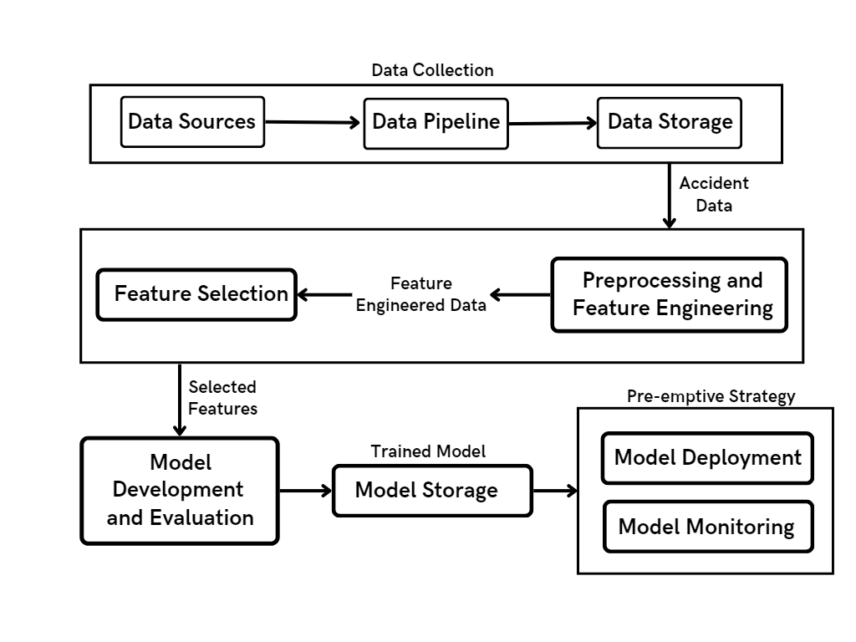
SYSTEM ARCHITECTURE

Slide 9
MODULES IDENTIFIED
Data collection module
(Module 1)
Data preprocessing and feature engineering module (Module 2)
Model development and evaluation module
(Module 3)
Deployment and monitoring module (Module 4)

Slide 10
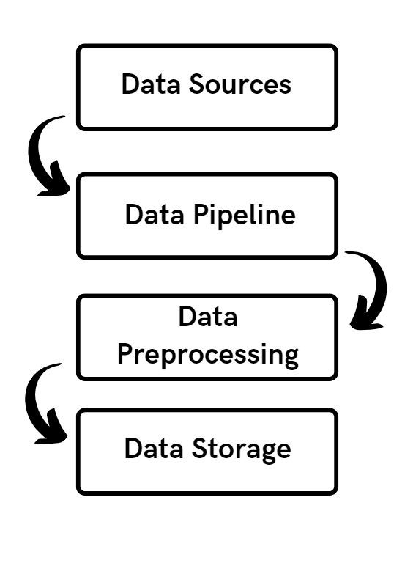
DFD and Module Description for the Data Collection Module
The data collection module is responsible for gathering data from various sources such as public databases, traffic cameras, and sensors.
In order to obtain raw data and store it in a data pipeline, this module uses data extraction and ingestion techniques.
The data gathered may contain specifics about accidents as well as information about the weather, the state of the road, the volume of traffic, and the type of vehicles involved.

Slide 11
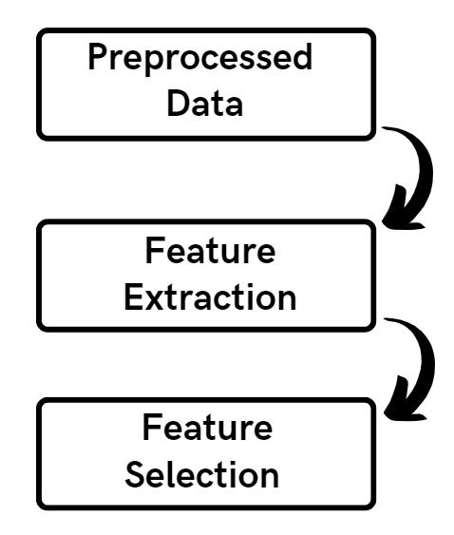
DFD and Module Description for the Data Preprocessing and Feature Engineering Module
The raw data must be converted into a structured format that machine learning algorithms can use via the data preparation and feature engineering module.
In order to make sure that the data is of good quality, consistent, and pertinent to the issue at hand, this module uses a variety of techniques, including feature scaling, data normalization, and data cleaning.

Slide 12
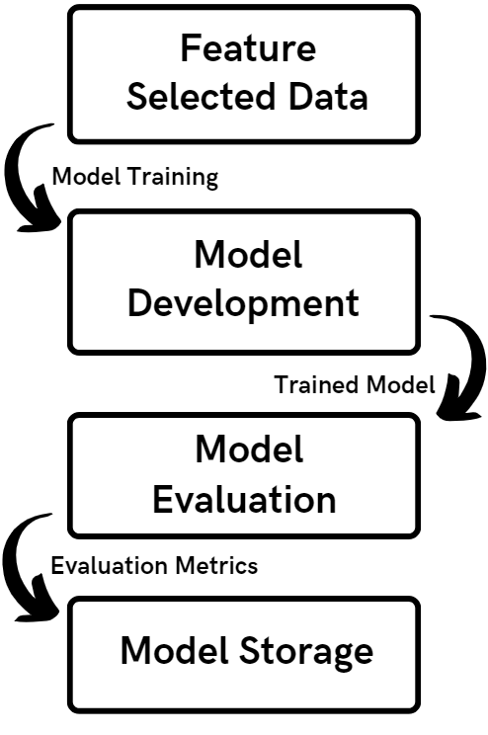
DFD and Module Description for the Model Development Module
A structured format for machine learning is created from raw data by the data preprocessing and feature engineering module.
To ensure quality and consistency, methods include scaling, normalization, and data cleansing.
For the purpose of predicting accidents, important variables including traffic flow, weather, and time of day are extracted.

Slide 13
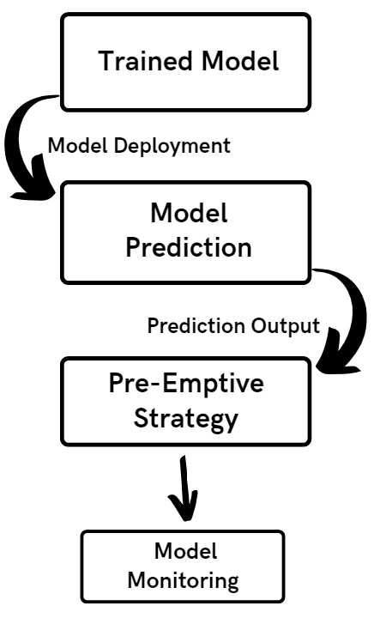
DFD for the Deployment and Monitoring Module
Deployment module involves implementing preemptive strategies based on the predictions of the machine learning models to prevent accidents before they occur.
Monitoring module continuously evaluates the effectiveness of the deployed preemptive strategies and collects feedback to improve their performance.
The output of this module is a system that can predict and prevent accidents in real-time, minimizing the risk of injuries and fatalities on the road.

Slide 14
References
Tingting Huang , Shuo Wang, Anuj Sharma
Highway crash detection and risk estimation using deep learning
Accident Analysis & Prevention, Volume 135, February 2020, 105392
Ammar Almasri, Sadiq Hussain, Maregu Assefa
Classification of Road Traffic Accident Data Using Machine Learning Algorithms
2019 IEEE 11th International Conference on Communication Software and Networks
Md. Farhan Labib, Ahmed Sady Rifat, Md. Mosabbir Hossain, Amit Kumar Das, Faria Nawrine
Road Accident Analysis and Prediction of Accident Severity by Using Machine Learning
2019 7th International Conference on Smart Computing & Communications (ICSCC)
H. Li, Y. Liu, J. Xie and J. Zhang
A Deep Learning Model for Traffic Accident Analysis
2019 IEEE 4th International Conference on Big Data Analytics (ICBDA), Hangzhou, China

Slide 15
Thank You!

